Slide 1
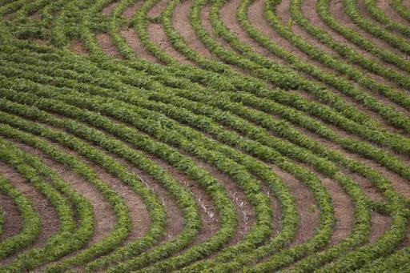
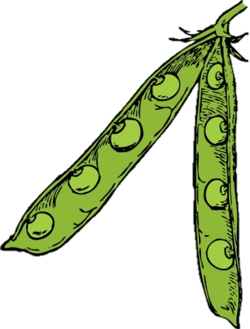
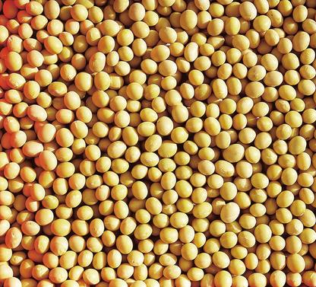
Developed by
Jayme Ericson, Dietetic Intern
Julie Garden-Robinson, Ph.D., R.D., L.R.D., Food and Nutrition Specialist
Notes:
Objectives:
Participants will be able to identify food sources of soy.
Participants will know what counts as a serving of soy.
Participants will know MyPlate recommendations for soy.
Participants will know how to prepare soy.

Slide 2
Which of these products are made from soy?
Tofu
Vegetable oil
Edamame
Soy sauce
Soy milk
Tempeh
Lecithin
Tamari
Miso
Notes:
Common Soy Products
Soy sauce
Soy sauce is created from fermented soybeans. Despite the salty taste, soy sauce actually is lower in sodium than traditional table salt. Miso and tamari are two variations of soy sauce made from soy beans.
Soy milk
Soy milk is a fluid produced from soaking and straining soybeans. It can be found in shelf-stable liquid or shelf-stable dry powder form, or refrigerated in the dairy case at your grocery store. Plain, unsweetened soy milk is an excellent alternative to cows’ milk and offers high-quality protein and B-vitamins. Soymilk is used to create a variety of products including soy cheese and soy ice cream.
Soybean oil
Soybean oil is derived from the natural oil found in whole soybeans. Oil sold in grocery stores under the name “vegetable oil” usually is 100 percent soybean oil or a blend of soybean oil and other oils. Soybean oil is rich in polyunsaturated fats and naturally cholesterol-free as opposed to butter.
Less Common Soy Products
Hydrolyzed vegetable protein (HVP)
HVP is the protein from vegetables, typically soybeans, and is used as a flavor enhancer in items such as soups, sauces, flavoring blends, canned and frozen vegetables, meats and poultry.
Soy protein isolates
Although the name sounds derived from a scientific lab, soy protein isolates (or isolated soy protein) essentially are soy flakes. They are a highly refined product designed to get the most protein out of the soybean. Soy protein isolates are 92 percent protein and are highly digestible.

Slide 3
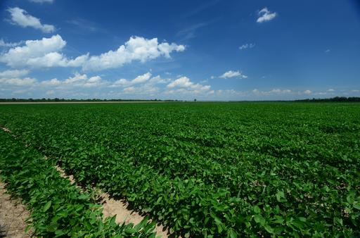
What is soy?
Soybeans are
a legume
native to Asia
Today’s Focus
Notes:
Soy is a plant native to Asia and has been a staple in the Asian diet for more than 5,000 years. Large-scale soybean cultivation did not start in the U.S. until around World War II. Today, the Midwestern U.S. produces about half of the world’s supply of soybeans. The popular bean is found in a wide variety of food products from tofu to infant formula, as well as nonfood products such as shampoo, diesel fuel and cosmetics.

Slide 4
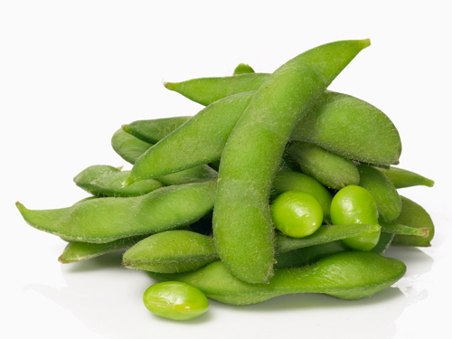
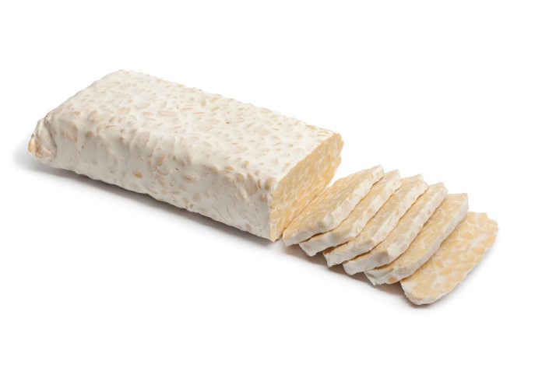
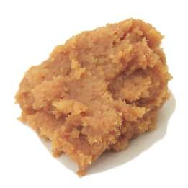
Soy Products
Edamame
Tempeh
Miso
Notes:
Edamame: Soybeans that are harvested when still green and sweet; can be shelled or unshelled, frozen or fresh, and take little preparation
Tempeh: Combination of fermented soybeans and a grain that is formed into a tender cake with a smoky, nutty flavor
Miso: Fermented soybeans sometimes mixed with rice to result in a thick paste used for sauces, spreads and soups
Lecithin: Product extracted from soybean oil and used as an emulsifier in many foods
Tamari: Gluten-free soy sauce

Slide 5
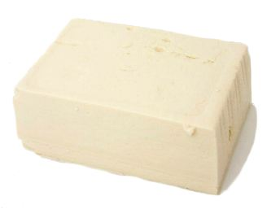
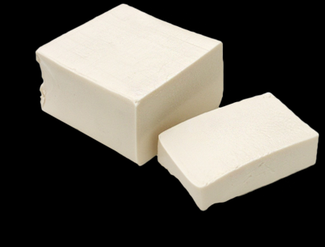
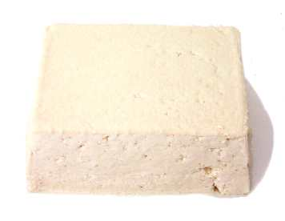
Soy Products
Soft tofu
Silken tofu
Firm tofu
Notes:
Tofu is a soft, creamy product made from curdling soy milk. Tofu is a naturally bland, high-quality protein that easily takes on the flavor of other foods with which it is cooked. Tofu comes in different forms: soft, firm and silken. Soft tofu is best used in blending recipes such as a smoothie. Firm tofu is great for holding its shape, such as in grilling or in a stir-fry. Silken tofu is great in creamier recipes, such as for replacing sour cream in a dip. Rich in protein, B-vitamins and calcium and low in sodium, tofu offers a great alternative to meat products.

Slide 6
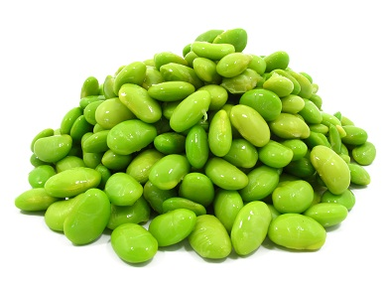
Uses of Soy in Food
Blending
Texture
Water absorption
Fat absorption
Many other uses
Notes:
Purposes in foods:
Emulsification
Soy flour and soy protein isolates help blend the fats for a smoother texture and palatability in high-fat foods, foods such as bologna, sausage, breads, cakes, soups and whipped toppings.
Fat absorption
Soy can be used to promote or prevent fat absorption in foods such as bologna, sausage, doughnuts and pancakes.
Water absorption
Soy flour and concentrates help in the uptake and retention of water in food products such as breads, cakes, macaroni and confections.
Texture
Soy flour and soy isolates are used to create viscosity, gelation (solidification by freezing) and fiber formation in foods such as soups, gravies and simulated meat products.
Other uses
Soy is used in a number of ways, including dough formation, cohesion, adhesion, elasticity, color control and aeration.

Slide 7
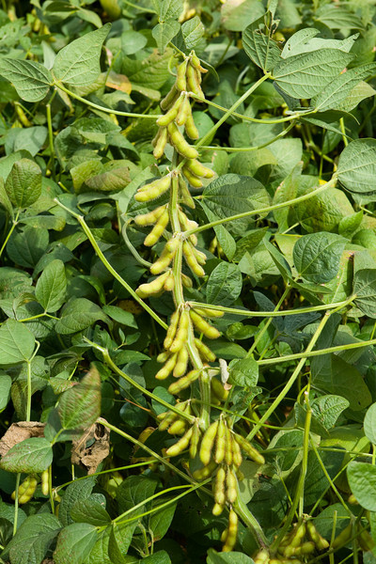
Soy Nutrition
Fiber
Vitamins
Minerals
Protein
Notes:
Soybeans provide protein, fiber (complex carbohydrates), and several vitamins and minerals. They contain no cholesterol and little to no fat. Adding soybeans to a healthful diet will help maintain good health.

Slide 8
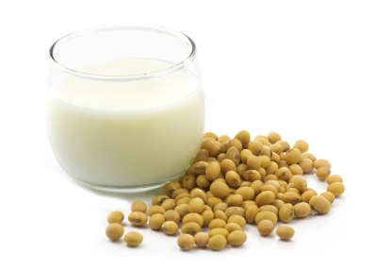
Soy Health Benefits
↓Menopause symptoms
↓Cancer risk
↓Blood pressure
↓Cholesterol
Notes:
Benefits:
Cholesterol: Research indicates soy consumption can decrease LDL cholesterol moderately in humans. This is most beneficial when soy protein is substituted for animal protein in the diet.
Blood pressure: Research shows soy consumption can help lower blood pressure in humans. Research still is needed to determine the best source and preparation of soybeans for this outcome.
Menopause: Research is limited on the relationship between soy consumption and menopause symptom reduction, but conclusions point to a reduction in hot flashes in menopausal women.
Cancer prevention: Research concludes that soy consumption can decrease the risk of breast cancer in women and prevent prostate cancer in men. Because soy contains estrogenlike chemicals, it should be used with caution in hormone-sensitive individuals.

Slide 9
The FDA on Soy
“25 grams of soy protein per day,
as a part of a diet low in saturated
fat and cholesterol, may reduce the risk of heart disease” - FDA
25 grams soy protein =
2.5 ounces soybeans, plain
or 10 ounces tofu, soft
or 3½ cups soy milk
Notes:
The Food and Drug Administration has authorized the use of a health claim on the association between soy protein and the reduced risk of coronary heart disease (CHD).
The food needs to include 6.25 grams of soy protein per reference amount customarily consumed (RACC), less than 1 gram of saturated fat per RACC, no more than 15 percent of calories from saturated fat per RACC and less than 20 milligrams of cholesterol per RACC.
Specifically, the label needs to state that “soy protein” is the beneficial part that can reduce CHD.

Slide 10
 | Reference Diet (used on food labels) | Tofu, firm (1/2 cup) | Soybeans (1/2 cup) | Soy milk, Plain (1 cup)
Calories | 2,000 | 88 | 155 | 108
Total fat (g) | Less than 65 | 5 | 8 | 4
Protein (g) | 50 | 10 | 15 | 6
Cholesterol (mg) | Less than 300 | 0 | 0 | 0
Fiber (g) | 25 | 1 | 5 | 0
Sodium (mg) | Less than 2,400 | 15 | 1 | 115
Notes:
Nutritional analysis of selected soybeans with a reference diet:
Source: U.S. Department of Agriculture. www.supertracker.usda.gov/
Experts recommend adults consume at least 25 grams of fiber per day.

Slide 11
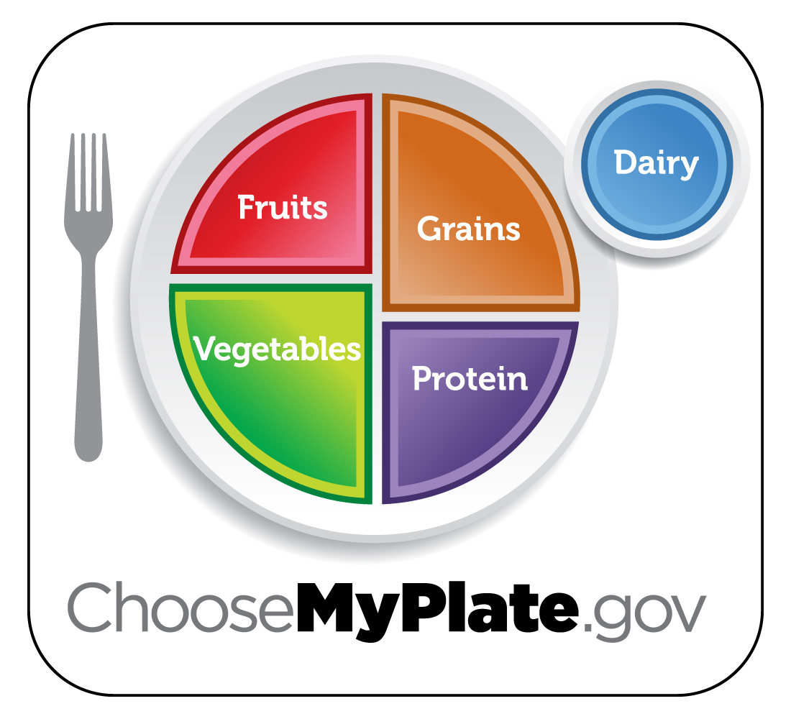
Soy
Notes:
MyPlate Recommendation
½ cup soybeans = ½ cup vegetables or 2 ounces protein (2.5 cups vegetables recommended daily)
½ cup cubed firm tofu = 2 ounces protein (5.5 ounces recommended daily)
1 cup soymilk = 1 cup dairy (3 cups recommended daily)

Slide 12
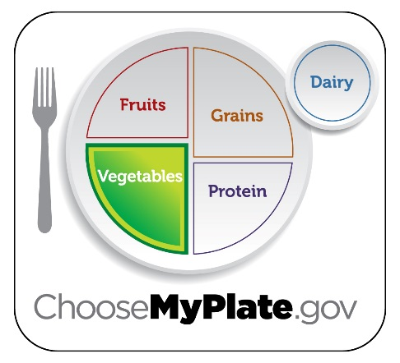
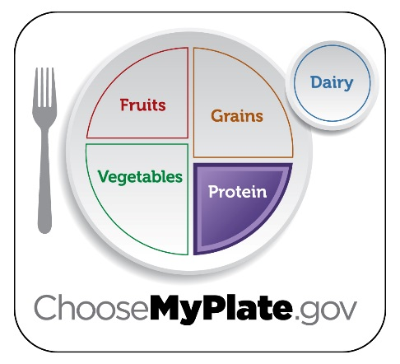
MyPlate Recommendations
Vegetable Group
½ cup soybeans =
½ cup serving of vegetables
Protein Group
½ cup soybeans = 2 ounce equivalent of protein
Notes:
Soybeans can count toward the Vegetable Group or the Protein Foods Group total. The amount of food you need from each group varies depending on gender, age and physical activity level. To find out what’s right for you, visit www.choosemyplate.gov and print out your daily food guide.
On average, adults need about 2.5 to 3 cups of vegetables per day and 5 to 6 ounce equivalents of meat and beans per day.
Soy milk can count as the Dairy Group servings.

Slide 13
Role of Soy in Special Diets
Gluten-free diet
Diabetic diet
Vegetarian diet
Weight management diet
Notes:
Gluten-free diet: Soybeans contain no gluten (protein found in wheat and some other cereal grains), so people with gluten intolerances (celiac disease) can include soybeans in their recipes.
Diabetic diet: Pulses may help with blood glucose management because of their low glycemic index (measure of how fast carbohydrate-containing foods raise blood sugar levels.) A low glycemic index means soybeans raise blood sugar slowly, compared with foods having a high glycemic index.
Vegetarian diet: Soybeans are a good source of protein, an essential part of the vegetarian diet.
Weight management diet: Soybeans are high in fiber and protein, leading to a feeling of fullness. They are also low in fat.
*When consuming extra fiber, be sure to drink plenty of water.

Slide 14
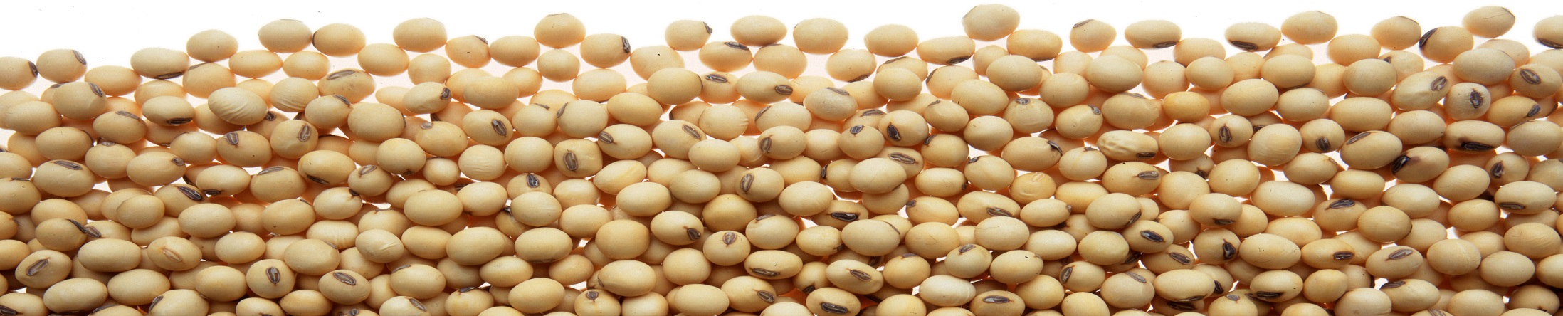
Preparing Soybeans
Canned or frozen soybeans
No soaking required
Rinse; boil, steam
or eat raw

Slide 15
Preparing Soybeans
Dry soybeans
Soak using conventional
or quick method
Drain and rinse
Prepare using
favorite method
Notes:
Soaking: Wash dried soybeans thoroughly and drain. For every 1 cup of dried soybeans, add 3 cups of water and 1 teaspoon of salt. Use any of the cooking methods below:
Conventional method: Soak soybeans overnight or eight to 10 hours. Drain and rinse thoroughly.
Quick soak: In a large saucepan, bring soybeans and water to a boil and then reduce to a simmer for two minutes. Remove from heat and let sit for an hour. Drain and rinse.

Slide 16
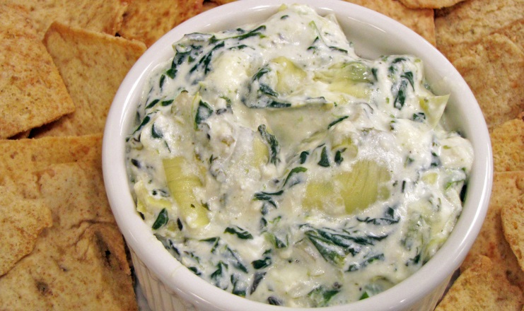
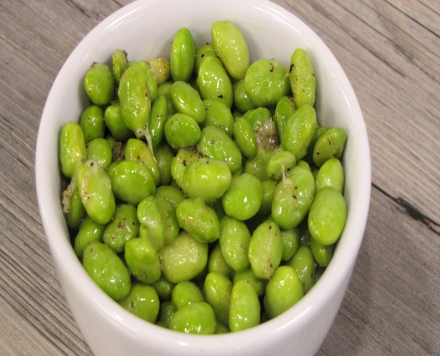
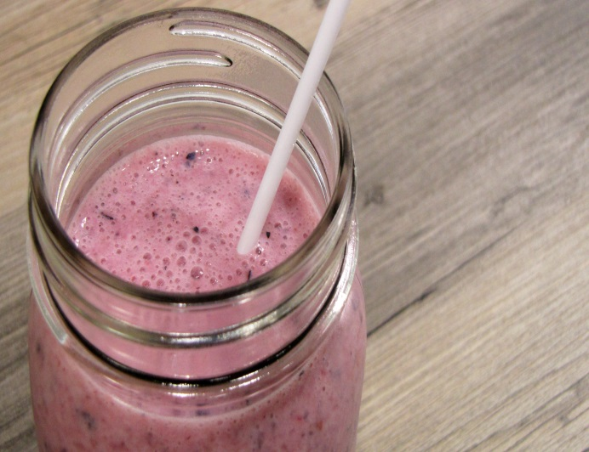
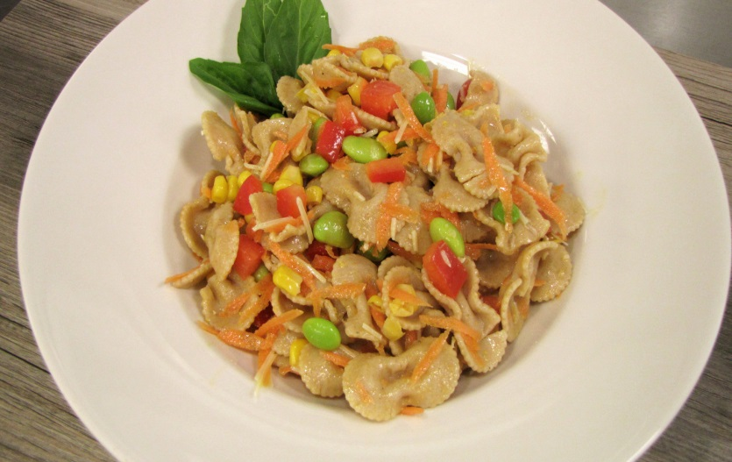
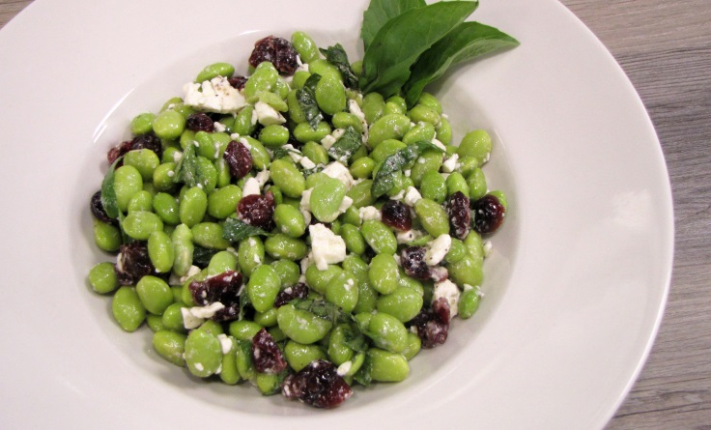

On the Menu: Soy
Breakfast
Main dish
Side dish
Soups
Snacks
Desserts
Notes:
Breakfast Recipes
Mixed-berry fusion smoothie
Breakfast burrito with tofu
Cereal with soymilk
Main Dish Recipes
Edamame bowtie pasta salad
Cranberry edamame salad
Soy burger
Taco salad with tofu crumbles
Tofu salad sandwich
Tofu veggie stir-fry
Tempeh
Side Dish Recipes
Crispy parmesan edamame
Soy and spinach artichoke dip
Vegetable three-bean soup
Baked potato with soybean chili
Dessert Recipes
Tofu peanut butter pie
Tofu mousse

Slide 17
Storing Soybeans
Uncooked
Cooked
Store dry, uncooked soybeans in a sealed container in a cool, dry place.
Refrigerate leftovers at
40 degrees F
and use within three days.

Slide 18
Top 10 Reasons to Use soybeans
Excellent source of fiber
Good source of B vitamins
Low fat
Low sodium
Good source of iron
Excellent source of protein
Good source of phosphorus
Low glycemic index
Gluten-free
Cholesterol-free

Slide 19
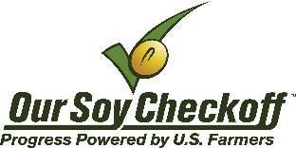

Additional Information
NDSU Extension Service
www.ag.ndsu.edu/food
MyPlate Website
www.choosemyplate.gov
American Soybean Association
https://soygrowers.com/
United Soybean Board
www.soyconnection.com/health_nutrition/health-fact-sheets/soy-heart-health/health-claim-guide
This project was made possible in part with funding from the North Dakota Soybean Council.
Notes:
References
Soyfoods: www.soyfoods.com/soy-food-descriptions/
Mayo Clinic: www.mayoclinic.org/drugs-supplements/soy/background/hrb-20060012
U.S. Department of Agriculture: www.supertracker.usda.gov/foodtracker.aspx

